Slide 1

FIFA World Cup Rankings Dataset
Ryan Meston Bellevue University

Slide 2
Abstract & Project Questions
The purpose of this project is to analyze FIFA World Cup rankings, player rankings, and game data to determine how many points a team needs to be ranked number 1 in the world.
The questions that I would like to answer are as follows:
Which country has the most championships?
Which teams are the most consistent?
Which confederation is strongest?
How does team strength relate to player performance?
Can we predict the next World Cup Champions?

Slide 3
Introduction & Background
The dataset I used for this project was found on Kaggle.com. This dataset houses all the FIFA World Cup Rankings data. The row headings for the dataset are as follows:
rank – team rank.
country_full – countries full name.
country_abrv – countries name abbreviated.
total_points – total points country received.
previous_points – countries previous points.
rank_change – countries rank change per week.
cur_year_avg – current points average.
cur_year_avg_weighted – current points weighted average.

Slide 4
Introduction & Background Continued
last_year_avg – last year points average.
last_year_avg_weighted – last year points weighted average.
two_year_ago_avg – two years ago points average.
two_year_ago_weighted – two years ago weighted average.
three_year_ago_avg – three years ago points average.
three_year_ago_weighted – three years ago points weighted average.
confederation – confederation the team belongs too.
rank_date – date team was ranked respected ranking.

Slide 5
Methodology
The six confederations that are listed in the dataset.
UEFA 14933
CAF 14876
AFC 12617
CONCACAF 9664
CONMEBOL 2860
OFC 2843
The figures below show which confederation has had the most number 1 rankings and how many times that confederation has been ranked number 1.
CONMEBOL 169
UEFA 117

Slide 6
Home Games vs Away Games
Home team games played:
Brazil: 84
Germany: 77
Argentina: 60
Italy: 49
France: 40
Away team games played:
Uruguay: 37
Italy: 34
Spain: 33
England: 33
Germany: 32

Slide 7
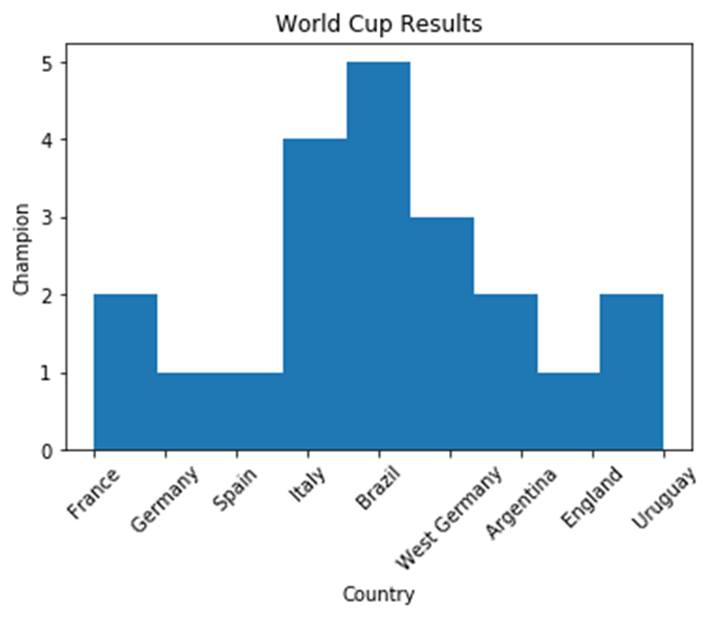
FIFA World Cup First Place Finishes
Teams first place finishes:
Brazil 5
Italy 4
West Germany 3
France 2
Argentina 2
Uruguay 2
England 1
Germany 1
Spain 1

Slide 8
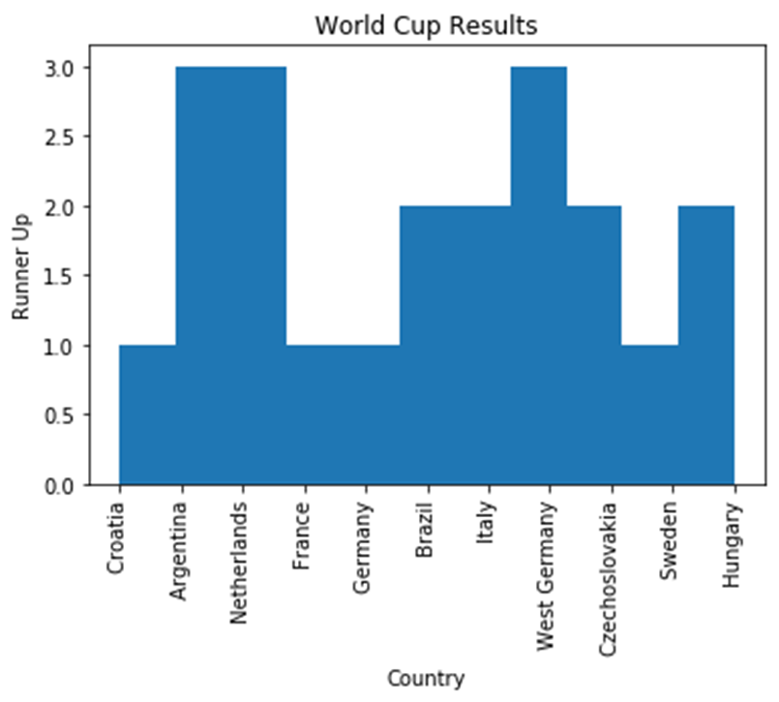
FIFA World Cup Second Place Finishes
Teams second place finishes:
Netherlands 3
West Germany 3
Argentina 3
Italy 2
Hungary 2
Brazil 2
Czechoslovakia 2
France 1
Sweden 1
Germany 1
Croatia 1

Slide 9
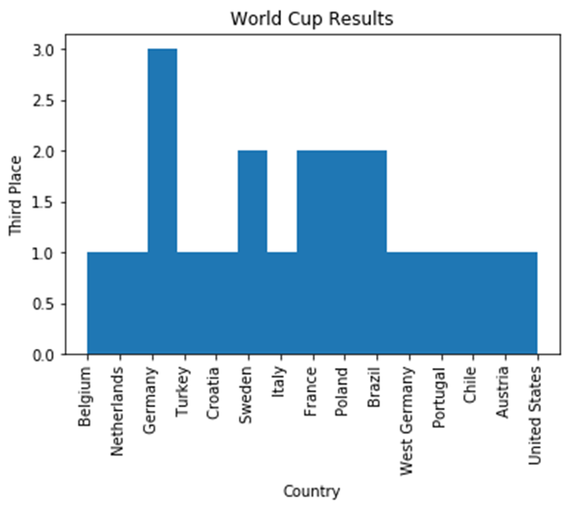
FIFA World Cup Third Place Finishes
Teams third place finishes:
Germany 3
Poland 2
Sweden 2
Brazil 2
France 2
Chile 1
Belgium 1
Croatia 1
United States 1
Portugal 1
Netherlands 1
Turkey 1
West Germany 1
Italy 1
Austria 1

Slide 10
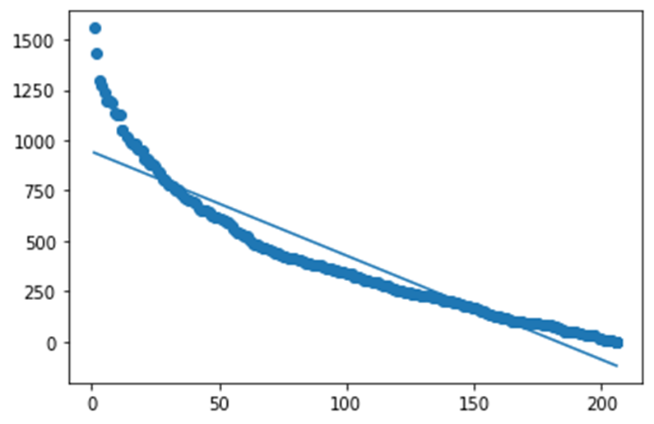
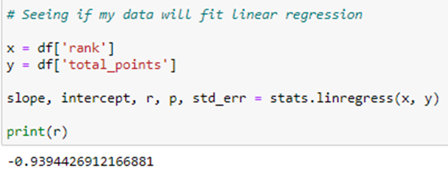
Linear Regression Model Fit

Slide 11
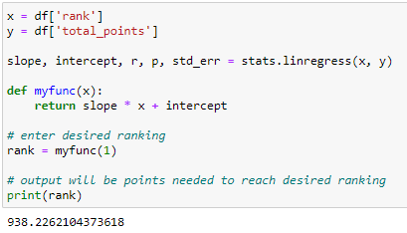
Results

Slide 12
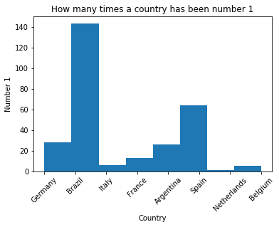
Results
Countries total number 1 ranking.
Brazil 143
Spain 64
Germany 28
Argentina 26
France 13
Italy 6
Belgium 5
Netherlands 1

Slide 13
Project Question Results
Which country has the most championships?
Brazil is the country with the most FIFA World Cup Championships. They have 5 total championships.
Which teams are the most consistent/ranked 1 most often?
Brazil is also the most consistent team with receiving a world 1 ranking over 143 times.
Which confederation is strongest?
The strongest confederation is the CONMEBOL confederation – The South American Football Confederation with 169 number world ranking.
How does team strength relate to player performance?
This question I am going to comeback to at a later date. I did not have time to scrape the player data I had to analyze it to answer this question.
Can we predict the next World Cup Champions? Changed to; how many points does a team need to rank # 1 worldwide?
I did not get to do a machine learning algorithm like I wanted to for this project, but I was able to use linear regression to show how many points a team would need to be in the running’s for a number world ranking. For a team to reach the rank of 1 worldwide they would need to have at least 938 points.

Slide 14
References
Fitzgerald, Tadhg. FIFA Soccer Rankings. https://www.kaggle.com/tadhgfitzgerald/fifa-international-soccer-mens-ranking-1993now
FIFA.com. FIFA World Ranking. https://www.fifa.com/fifa-world-ranking/men?dateId=id13295
Jurisoo, Mart. International Football Results from 1872 – 2021. https://www.kaggle.com/martj42/international-football-results-from-1872-to-2017/data
Muriuki, Gerald. June 8, 2018. Predicting FIFA World Cup 2018 Using Machine Learning. https://blog.goodaudience.com/predicting-fifa-world-cup-2018-using-machine-learning-dc07ad8dd576
Dar, Pranav. June 13, 2018. Data Scientists built a Random Forest Model to predict the World Cup 2018 Winner. https://www.analyticsvidhya.com/blog/2018/06/data-scientists-used-a-random-forest-model-to-predict-the-world-cup-2018-winner/
whoscored.com. https://www.whoscored.com/Regions/247/Tournaments/36/Seasons/5967/Stages/12763/PlayerStatistics/International-FIFA-World-Cup-2018
PDF. https://img.fifa.com/image/upload/hzfqyndmnqazczvc5xdb.pdf
FIFA.com Official Documents. https://www.record-evolution.de/en/fifa-world-cup-statistics-data-modeling-with-repods-part-i/
The Soccer World Cups.com https://www.thesoccerworldcups.com/stats.php
FBRef.com. 2014 FIFA World Cup Stats. https://fbref.com/en/comps/1/1709/2014-FIFA-World-Cup-Stats
Foxsports.com. FIFA World Cup. https://www.foxsports.com/soccer/fifa-world-cup/history

Slide 15
10 Questions
How many games do the top ten teams play per year to maintain their dominance?
How many points do the top teams score in each match?
How many points are scored on the top teams in each match?
How strong is each national team’s roster?
How do the second-string players rank nationally compared to other teams first string players?
Why are other conferences less dominant in the sport?
Who was the coach on the championship teams?
Who was the staff on the championship teams?
Which player has appeared in the most FIFA World Cups?
Who are the most valuable players on each national team?

